Slide 1
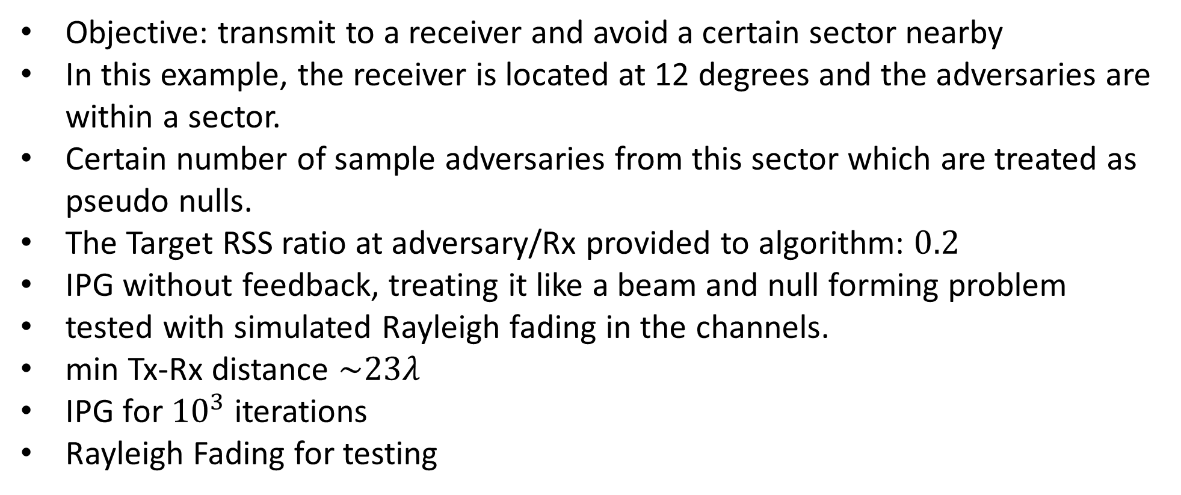
Adversaries in a Sector
Objective: transmit to a receiver and avoid a certain sector nearby
In this example, the receiver is located at 12 degrees and the adversaries are within a sector.
Certain number of sample adversaries from this sector which are treated as pseudo nulls.
The Target RSS ratio at adversary/Rx provided to algorithm: $0.2$
IPG without feedback, treating it like a beam and null forming problem
tested with simulated Rayleigh fading in the channels.
min Tx-Rx distance $\sim 23λ$
IPG for ${10}^{3}$ iterations
Rayleigh Fading for testing

Slide 2
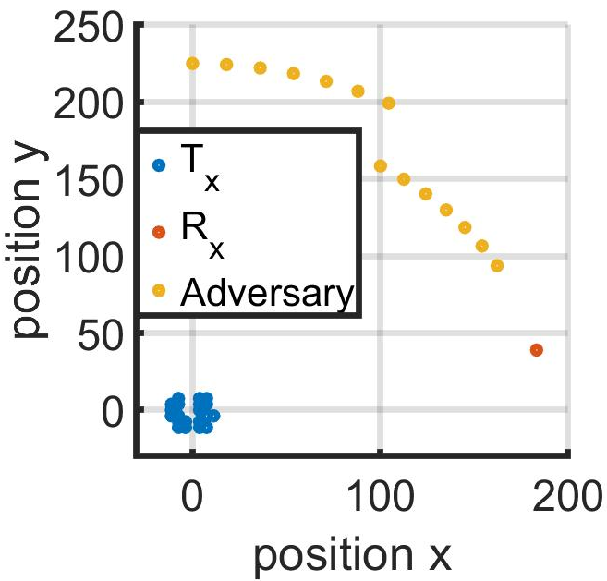
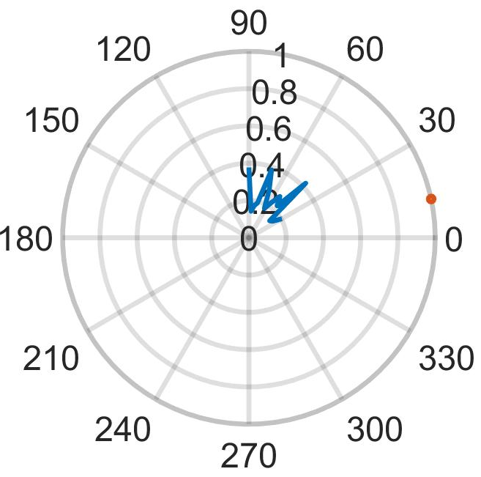

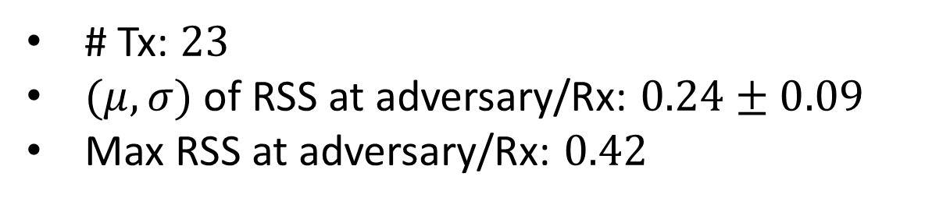
Adversaries: ${30}^{°}−{90}^{°}$
# Tx: $23$
$(μ,σ)$ of RSS at adversary/Rx: $0.24±0.09$
Max RSS at adversary/Rx: $0.42$

Slide 3
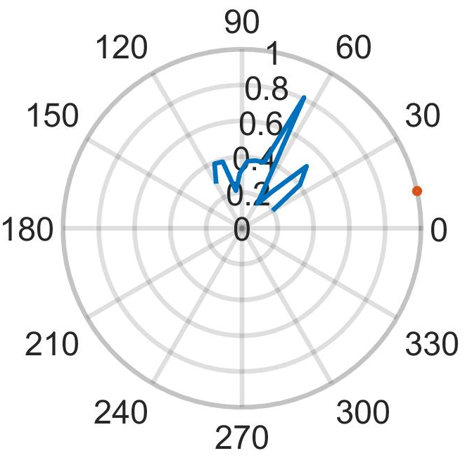
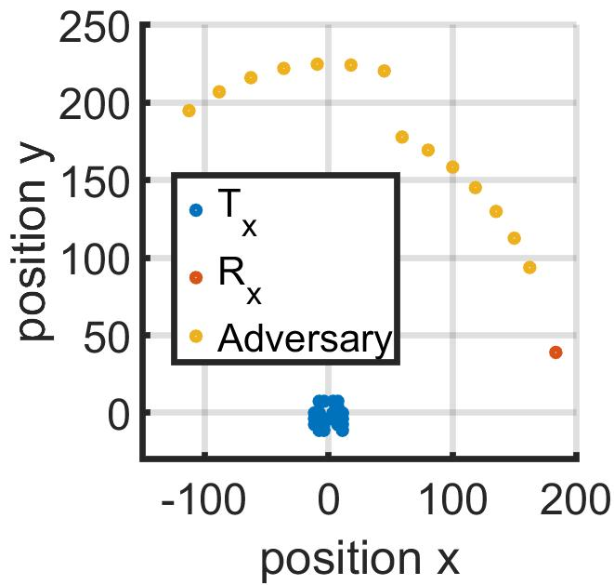
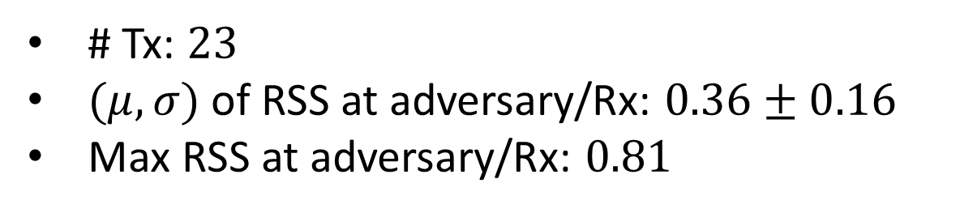

Adversaries: ${30}^{°}−{120}^{°}$
# Tx: $23$
$(μ,σ)$ of RSS at adversary/Rx: $0.36±0.16$
Max RSS at adversary/Rx: $0.81$

Slide 4
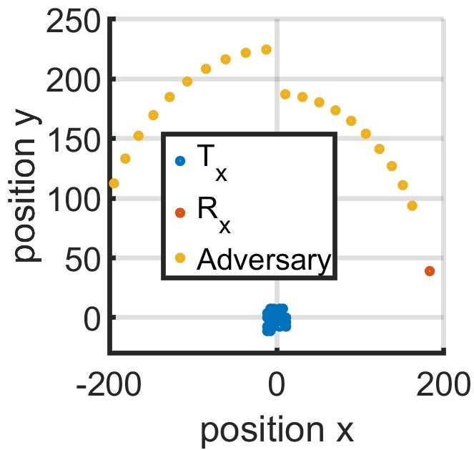
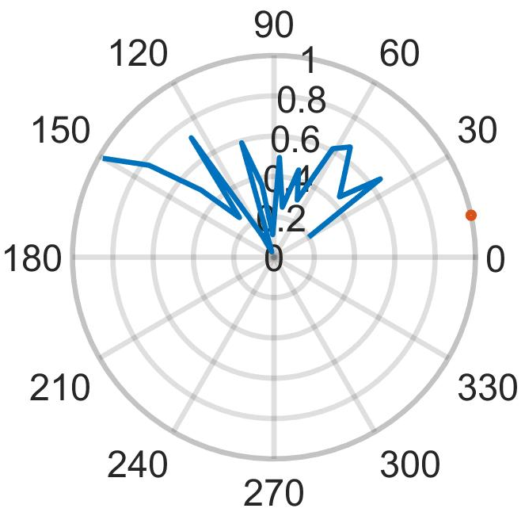
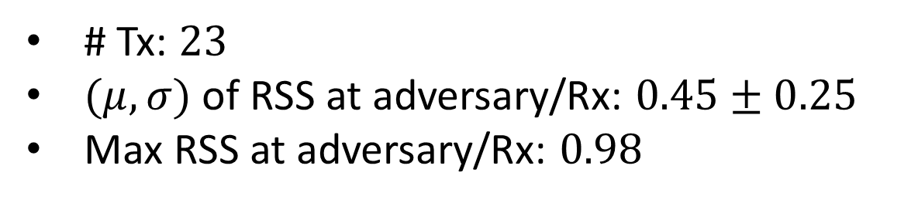

Adversaries: ${30}^{°}−{150}^{°}$
# Tx: $23$
$(μ,σ)$ of RSS at adversary/Rx: $0.45±0.25$
Max RSS at adversary/Rx: $0.98$

Slide 5
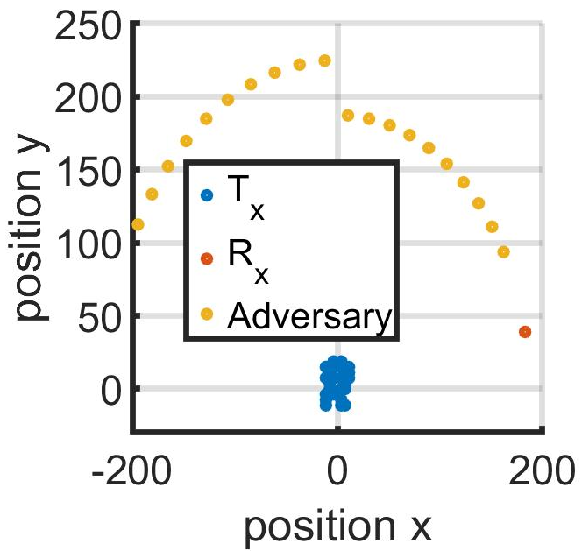
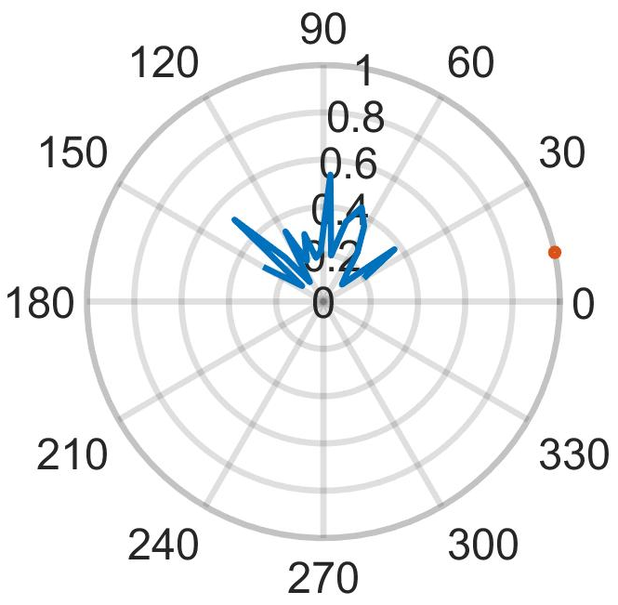
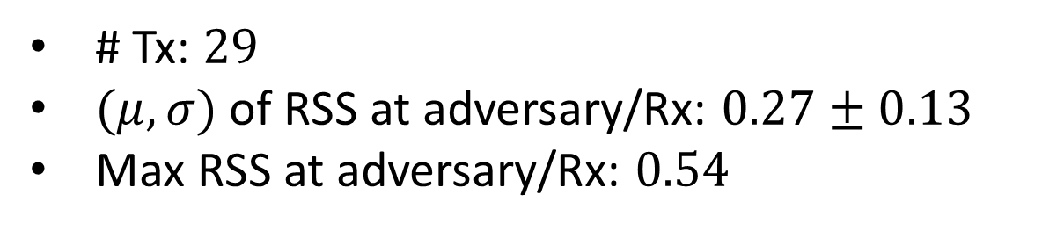
Adversaries: ${30}^{°}−{150}^{°}$
# Tx: $29$
$(μ,σ)$ of RSS at adversary/Rx: $0.27±0.13$
Max RSS at adversary/Rx: $0.54$

